Slide 1
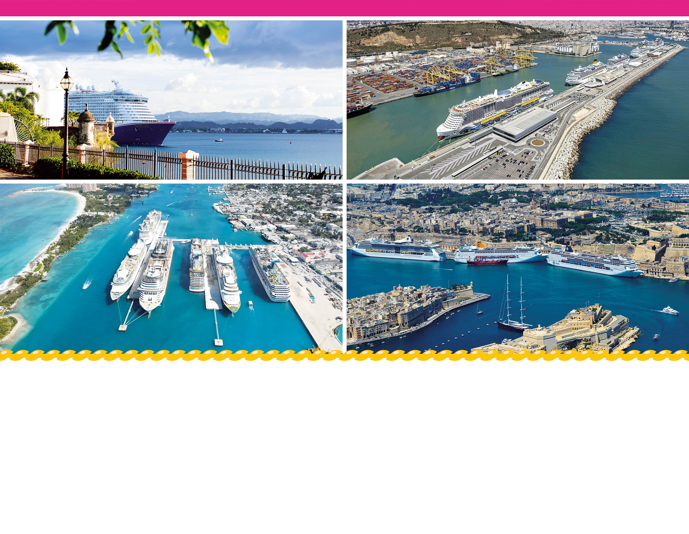
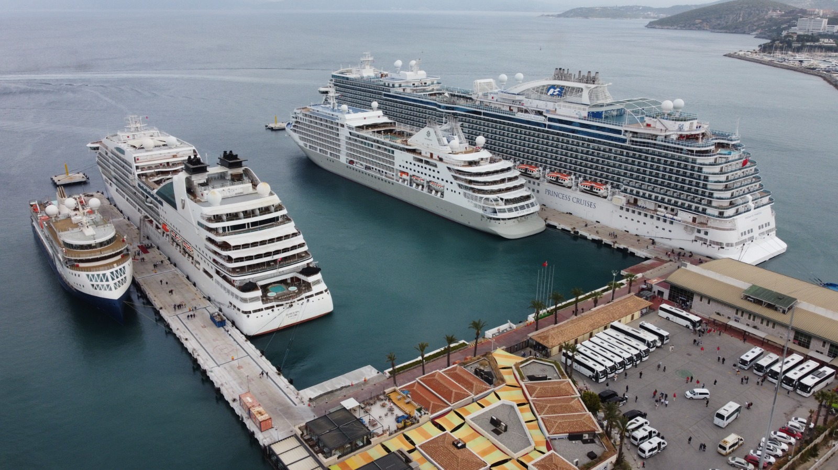

Global Ports Holding Plc
Half year results to 30 September 2023
Further significant growth expected
December 2023

Slide 2
Contents
GPH Overview
The Cruise Market and GPH’s Business Model
H1-2024: Financial Review
Inorganic Expansion Update
Outlook
Appendix
2

Slide 3
GPH Overview

Slide 4




GPH: 20 Years of Success
Founded in 2003
Built successful track record operating multi-modal ports in Turkey
Won, expanded and operated 3 internationally oriented facilities around the country
Deploy expertise globally, win new concessions across Europe and Asia
2015: European Bank of Reconstruction & Development (EBRD) acquires ~11% ownership, supporting GPH’s global expansion⁽¹⁾
  GPH continues to follow EBRD environmental guidelines
2017 IPO on London Stock Exchange
Firmly established as world’s dominant, geographically diversified cruise infrastructure portfolio
Freshly invested, long term CPI linked concession portfolio
Divested commodity-oriented port business
Emphasis on adding ancillary revenues such as port agency services at existing ports with the same cost base
Continued addition of selective new ports to the network
Ongoing cultivation and expansion of GPH’s ports revenue streams across the global asset base
2003-2013:
“Origins”
2014-2018:
“Global Expansion”
Establishing our
Global Presence
2019-2024:
“Maturity” Globally
Dominant Cruise
Infrastructure Platform
The Future
3 Assets
17 Assets
31 Assets
Continued growth
1 Country
9 Countries
18 Countries
Note: (1) EBRD reduced share at IPO and exited fully shortly afterwards, as planned when making the investment, as EBRD's "mission" was completed with the IPO
4
Notes:
800,686 – St. Lucia Cruise
384,088 – HIA St. Lucia
98,713 – GFLC St. Lucia
https://businessviewcaribbean.com/vc-bird-international-airport-antigua/
~860,000 passengers per year implying ~430,000 emplanements
733,526 - number from GPH “Historical Cruise Calls and Pax”

Slide 5

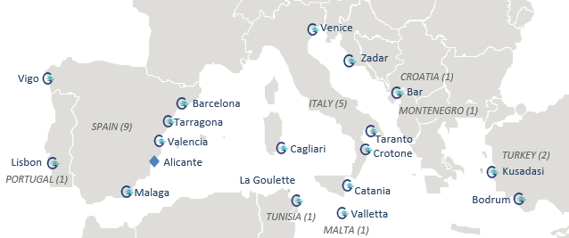

GPH: Global Footprint
Dominant position in the Mediterranean cruise port landscape and established presence in the Caribbean and Asia
Kalundborg
Prince Rupert
DENMARK (1)
CANADA (1)
Bremerhaven
GERMANY (1)
Lanzarote
Fuerteventura
Las Palmas
Ha Long
Nassau
VIETNAM (1)
THE BAHAMAS(1)
San Juan
ANTIGUA & BARBUDA (1)
Singapore
PUERTO RICO (1)
Antigua
SINGAPORE (1)
St Lucia
St Lucia (1)
Assets in Portfolio
Passengers Served
Long-term concession model
Competition
28 cruise ports incl Bremerhaven starting operations in 2025
+2 in process of closing
(St Lucia and San Juan)
Significant opportunities to grow the network
12.5m Consolidated portfolio PAX(1)
Expected to increase to in excess of 16m PAX in the consolidated portfolio in FY 2025
Close to 20m PAXs for total portfolio
27 years remaining on concessions⁽²⁾
Significant number of extension options available-
Majority of cruise ports currently government-owned and operated
Rare to have two ports competing at same destination
Note: (1) FY 2024 expectations based on current call list (2) Based on weighted average EBITDA expected in FY 2024
5

Slide 6
The Cruise Market and GPH’s Business Model

Slide 7
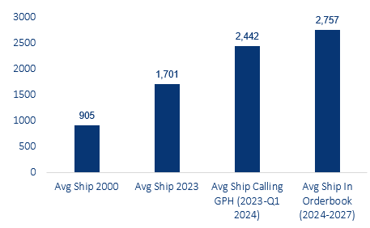
The Cruise Market and GPH’s Business Model
Cruise Industry Dynamics
Cruise facilities are generally underinvested and in need of investment to meet the needs of the growing industry and passengers' expectations
Cruise ships usually operating in excess of 100% capacity year-round
Generally, itineraries scheduled 18 - 24 months in advance
Current cruise ship order book is for 68 new cruise ships and extends to out to 2028
YoY growth globally 2000-2019 +5.1% vs aviation 3.3%, with less volatility
Average size of ships (Berths)
Global Cruise Passengers 1995 – 2019 (thousand)
Global CAGR: ~6%
ISIS
Tunisia
ECONOMIC
CRISIS
Concordia
Libya
Enduring Freedom
SARS
Mexican Crime
9-11
Afghanistan
Kosovo
Source: Cruise Industry News 2022 State of the Industry Report
7

Slide 8

The Cruise Market and GPH’s Business Model
5 Largest Cruise Ports in The Caribbean⁽¹⁾
(Million Pax, 2019)
5 Largest Cruise Ports in The Mediterranean
(Million Pax, 2019)
1.8
GPH Ports
Other Ports
GPH Ports in closing
Source: MedCruise Traffic Data 2019 & Jamaican Tourism Board (1) Current portfolio within 2019 numbers
8

Slide 9
The Cruise Market and GPH’s Business Model
Business model – concession framework
GPH’s invests in and operates cruise ports under long term concessions
  Weighted average 27 years left on current concessions
  Automatic or investment-triggered extension options often in place
Typical concession involves investment into cruise port facilities as part of concession award
Annual concessions fees often also payable
Revenue derived from Primary Port Services and Ancillary Revenue
Growth primarily driven by adding new ports to the network, growing passenger volumes and providing new ancillary services at each port
The cruise industry has a long term track record of YoY industry growth. The future growth of the industry is highly visible, driven by new ship orders and the increase in the size of ships.
Customer booking patterns are longer than in land based tourism and aviation. This longer booking pattern means that historically the cruise industry has performed well in a recession, both in absolute terms & relative to land-based tourism and aviation.
9

Slide 10






































The Cruise Market and GPH’s Business Model
Ancillary Revenues: Optimizing the Potential
Monetizing Passengers
Analogy to Airport
1
GPH B2C Business Model: Understanding Passenger Needs Drives New Products and Services
Before GPH
These can be thought of as optimized and enhanced non-nautical monetization opportunities and configuring passenger flow and floor space to enhance sales per pax / m²
Passengers Embark / Disembark through Simple Terminal
GPH B2C Approach
After GPH
Upgraded Terminals To Drive Non-Nautical Passenger Spend on Value-Add Services
Restaurants and Cafes
Advertisement
Bus and Transfers
Taxi Services
WiFi
Retail Sales
Concierge, City Map
Car Rental, Parking
Shore Excursions
Monetizing Liners
Analogy to Airport
2
Additional Products and Services
Customers
These can be thought of as the non-passenger charge aeronautical revenues such as landing charges, boarding bridge charges, aircraft parking, fueling etc.
Terminal Services (incl. Luggage Handling)
GPH services more than 70+ cruise brands worldwide
Marine Services, inc. Pilotage, Towing, Mooring, Sheltering, Security, Port Agency Services
Waste Removal and Freshwater
Integrated Port Services
10
Notes:
800,686 – St. Lucia Cruise
384,088 – HIA St. Lucia
98,713 – GFLC St. Lucia
https://businessviewcaribbean.com/vc-bird-international-airport-antigua/
~860,000 passengers per year implying ~430,000 emplanements
733,526 - number from GPH “Historical Cruise Calls and Pax”

Slide 11
H1-2024: Financial Review

Slide 12
Strong Recovery and Continued Growth in Cruise Performance
Monthly GPH Cruise Calls fiscal years 2020, 2023 & 2024
GPH’s cruise operations have transformed in scale and reach vs. pre-pandemic
Continued Strong improvement in cruise KPIs in 6 months to end Sept 2023
  Cruise calls up +16% in the 6M Reporting Period ending 30 Sept 2023 compared to comparable period in FY 2023
  In line with expectations / call list at the beginning of the fiscal year and exceeding pre-pandemic level
  Strong recovery in cruise passenger volumes
  6.7m passengers in the 6M Reporting Period compared to 4.3m in comparable period in FY 2023 translating into +54%
  Stronger pax growth driven occupancy levels returning to pre-pandemic levels across all regions
Strong call reservations for remainder of fiscal year 2024
  Cruise call reservations at consolidated ports for fiscal year 2024 well above pre-pandemic level
  +12.5m passengers expected for full FY2024
  Occupancy at GPH ports in excess of 100% since February 2023
  Average occupancy rate in fiscal year 2024 to date 108%
Monthly GPH Passengers fiscal years 2020, 2023 & 2024 (‘000 pax)
FY2020 data includes the comparative information for two major ports acquired during the year : Antigua Cruise Port and Nassau Cruise Port. 2022 and 2023 data
includes new ports added since 2019: Kalundborg, Las Palmas, Vigo, Crotone, Taranto, Tarragona and Prince Rupert. 2024 Expectations as of March 2023
12

Slide 13
Strong Recovery and Continued Growth in Cruise Performance (cont’d)
GPH Key Ports* Cruise Passengers Actuals as % of 2019
* Based on largest GPH ports: Nassau, Antigua, Barcelona, Malaga, Valletta, and Ege.
13

Slide 14
Record Half Year Performance
GPH Selected Key Preliminary Financials for period ending 30 Sept 2023 ($m)
 | 6M Sept 2023 | 6M Sept 2022 | YoY Change | 12M Mar 2023
Passengers (m) | 6.7 | 4.3 | 54% | 9.2
Adjusted Revenue ($m) | 95.9 | 64.1 | 50% | 117.2
Segmental EBITDA ($m) | 67.6 | 44.0 | 54% | 80.0
Group costs ($m) | (3.4) | (3.6) | 5% | (7.3)
Adjusted EBITDA ($m) | 64.1 | 40.4 | 59% | 72.7
Segmental EBITDA Margin (%) | 70.4% | 68.7% |  | 68.3%
Adjusted EBITDA Margin (%) | 66.9% | 63.0% |  | 62.0%
 | 6M Sept 2023 | 31 Mar 2023
Gross Debt ($m) | 679.5 | 612.3 | 11%
Net Debt ($m) | 561.1 | 494.0 | 13%
Cash ($m) | 118.4 | 118.3 | 0%
Net Debt/LTM Adj EBITDA | 5.8x | 6.7x
  6.7m passengers in 6M Reporting Period ending 30 Sept 2023 compared to 4.3m in the comparable period in FY2023
  Adjusted Revenue of USD 95.9m has grown 50% YoY and compares to USD 64.1m in the same period in FY2023
  Segmental EBITDA of USD 67.6m has grown 54% YoY and compares to USD 44.0m in the same period in FY2023
  Adjusted EBITDA of USD 64.1m, has grown 59% YoY and compares to USD 40.4m in the same period FY2023
  Increase in gross debt driven by financing refinancing of Sixth Street loan generating excess cash, impact to cash offset by investment into ports, primarily Nassau and Ege extension
14

Slide 15
Record Half Year Performance
GPH Regional Breakdown 6M Results for period ending 30 Sept 2023 ($m)
 | 6M Sept 2023 | 6M Sept 2022 | YoY Change
 |  |  | (%)
Americas
Passengers (m) | 2.2 | 1.6 | 37%
Adjusted Revenue ($m) | 22.8 | 14.8 | 54%
Segmental EBITDA ($m) | 14.3 | 9.5 | 50%
EBITDA Margin (%) | 62.8% | 64.6%
Revenue Yield per PAX | 10.2 | 9.0 | 13%
West Med & Atlantic
Passengers (m) | 2.2 | 1.3 | 74%
Adjusted Revenue ($m) | 24.2 | 16.1 | 50%
Segmental EBITDA ($m) | 20.0 | 11.3 | 77%
EBITDA Margin (%) | 82.6% | 69.7%
Revenue Yield per PAX | 11.0 | 12.7 | -14%
Central Med
Passengers (m) | 1.2 | 0.7 | 71%
Adjusted Revenue ($m) | 15.4 | 10.0 | 55%
Segmental EBITDA ($m) | 8.3 | 6.1 | 35%
EBITDA Margin (%) | 53.6% | 61.5%
Revenue Yield per PAX | 12.3 | 13.6 | -10%
 | 6M Sept 2023 | 6M Sept 2022 | YoY Change
 |  |  | (%)
East Med & Adriatic
Passengers (m) | 1.0 | 0.7 | 41%
Adjusted Revenue ($m) | 25.3 | 17.4 | 45%
Segmental EBITDA ($m) | 21.4 | 14.7 | 45%
EBITDA Margin (%) | 84.6% | 84.7%
Revenue Yield per PAX | 25.5 | 24.8 | 3%
Other
Adjusted Revenue ($m) | 8.3 | 5.8 | 42%
Segmental EBITDA ($m) | 3.7 | 2.4 | 54%
EBITDA Margin (%) | 44.0% | 40.5%
Unallocated (HoldCo)
Unallocated Expenses. | (3.4) | (3.6) | -5%
Group
Passengers (m) | 6.7 | 4.4 | 54%
Adjusted Revenue ($m) | 95.9 | 64.1 | 50%
Adjusted EBITDA ($m) | 64.1 | 40.4 | 59%
EBITDA Margin (%) | 66.9% | 63.0%
Revenue Yield per PAX | 14.3 | 14.7 | -3%
For definition of terms, please refer to Condensed Financial Statements
15

Slide 16
Strong cash performance
Solid Cash Flow Performance
Cash Flow 6M Results for period ending 30 Sept 2023 ($m)
Cash flow | 6M Sept 2023 | 6M Sept 2022
Operating (loss) / profit ($m)
Depreciation and Amortization ($m) | 17.2 | 13.3
Specific Adjusting Items ($m) | 8.4 | 3.9
Profit share equity-accounted investees ($m) | 4.0 | 1.2
Adjusted EBITDA ($m) | 64.1 | 40.3
Working capital ($m) | (23.4) | 3.8
Other ($m) | (11.9) | (4.1)
Operating Cash flow ($m) | 28.8 | 40.0
Net interest expense ($m) | (31.0) | (11.5)
Tax paid ($m) | (0.9) | (0.9)
Net capital expenditure incl. advances ($m) | (48.6) | (43.9)
Free cash flow ($m) | (51.7) | (16.3)
Change in Gross debt ($m) | 53.8 | (2.2)
Dividends received ($m) | 2.1 | --
Related Party financing ($m) | 1.0 | 5.9
Net Cash flow ($m) | 5.2 | (12.6)
  Solid underlying cash flow performance
  USD 28.8m of operating cash flow compared to a USD 40.0m
  Significant increase in EBITDA, offset by working capital outflow of USD 23.4m and other operating outflows of USD 11.9m
  One-off working capital outflows
  USD 23.4m working capital reflects impact of increase in trade receivables as ports returned to normal operating levels
  One-off impact from Nassau trade receivables of USD 13m
  Timing impact on net interest expense
  Net interest expense of USD 31.0m,, rose sharply, primarily due to interest due for Sixth Street loan was payable in form of PIK Interest (adding to the outstanding nominal instead of cash payment) until year-end 2022 as well as the prepayment costs for early refinancing of the loan
  Net capital expenditure of USD 48.6m primarily reflects investment into Nassau Cruise Port and Ege Port extension
For definition of terms, please refer to Condensed Financial Statements
16

Slide 17
Debt maturity profile
Debt Maturity Profile Group ($m)
  Significant improvement of debt maturity profile
  GPH issued USD 330m secured private placement notes at a fixed coupon of 7.87% end of Sept 23
  Notes received an investment grade credit rating from two rating agencies and will fully amortize over 17 years, weighted average maturity of c13 years
  Majority of proceeds used to repay outstanding senior secured loan from Sixth Street incl. early repayment fees and accrued interest
  Balance of proceeds will primarily be used to fund further Caribbean expansion and transaction costs & reserve accounts
  Fixed rate & investment grade debt
  >90% of GPH’s gross debt now fixed rate and close to 85% is made up of the investment grade rated notes and the ring-fenced bonds / notes of Nassau Cruise Port
Scheduled Payments GPH Group: Nominal Amounts Outstanding as of 31 March 2023 & 30 Sept 2023 ($m)
18

Slide 18
Inorganic Expansion Update

Slide 19
Barcelona Cruise Port and Ege Cruise Port Extension
Ege Cruise Port Extension
St Lucia Cruise Port
GPH extended its concession agreement for Ege Port, Kusadasi, by 19 years. This concession now ends in July 2052.
Ege Port paid an upfront concession fee of TRY 725.4 million (USD 38 million at the exchange rate at the time of payment).
In addition, Ege Port will invest TRY 72.5m within the next five years to improve the facilities at the port. A variable concession fee of 5% of gross revenues will be paid from July 2033.
A capital increase at Ege Port funded the upfront concession fee. This capital increase was provided by GPH only. As a result, GPH's equity stake in Ege Port has increased to 90.5% (from 72.5%).
30-year port concession agreement, with a potential 10-year extension option
Welcomed c590k passengers in 2023, c790k in 2019
GPH to invest in material expansion and upgrade of cruise port facilities
Investment will expand existing berthing, increasing capacity and allowing the port to handle the largest cruise ships in the world. Retail facilities to be redeveloped
Passenger volumes expected to rise to over 1m in the medium term
GPH expects to take over operations shortly, simultaneous to financial closing
Bremerhaven Cruise Port
BPI Share Purchase
10-year port concession agreement, with a potential 5-year extension option signed
Welcomed 230k passengers in 2023, over 90% homeport passengers
Ideally located for Scandinavian and Baltic Sea itineraries and will become GPH’s second port in Northern Europe
Cruise facilities currently undergoing multi-million Euro investment by port authority
No CAPEX or other upfront financing commitment, but fixed lease committed
GPH to take over operations in Q1 CY 2025
After end of interim period GPH purchased a 38.0% holding in Barcelona Port Investments S.L. (BPI), taking its ownership to 100% of BPI
GPH’s indirect holding on Creuers De Port De Barcelona S.A. now 100%, increasing GPH’s stake in Barcelona Cruise Port and Malaga Cruise Port to 100%
GPH’s effective ownership Singapore Cruise Port has risen to 40% from 24.8% and the effective interest in Lisbon Cruise Port has increased to 50% from 46.2%.
No impact to consolidated revenue and EBITDA, but proportionate values increase
24

